Slide 1
Module 1: Understanding the Digital4Sustainability Curricula
Notes:
Welcome to Module 1. In this session, we will explore the architecture of the Digital4Sustainability curricula. It is essential for every trainer to understand how these programmes are built, as they are specifically designed to support Europe’s twin transition by aligning digital skills with sustainability goals.

Slide 2
Curriculum Architecture: Core vs. Upskilling programmes.
The Three Pillars: Understanding PLOs, ULOs, and LUs.
Core Educational Profiles: Five pathways for the workforce.
Targeted Upskilling: Six specialized curricula for rapid development.
European Frameworks: Alignment with EQF, e-CF, and GreenComp.
Notes:
Before we dive into the details, let’s look at our roadmap for this module. We will start with the big picture—the curriculum architecture—and then break it down into its structural elements. We will also introduce the specific educational profiles and upskilling pathways we’ve developed, and finally, look at the European frameworks that ensure our training meets the highest quality standards. Since this is a self-paced module, feel free to revisit any of these sections as needed.

Slide 3
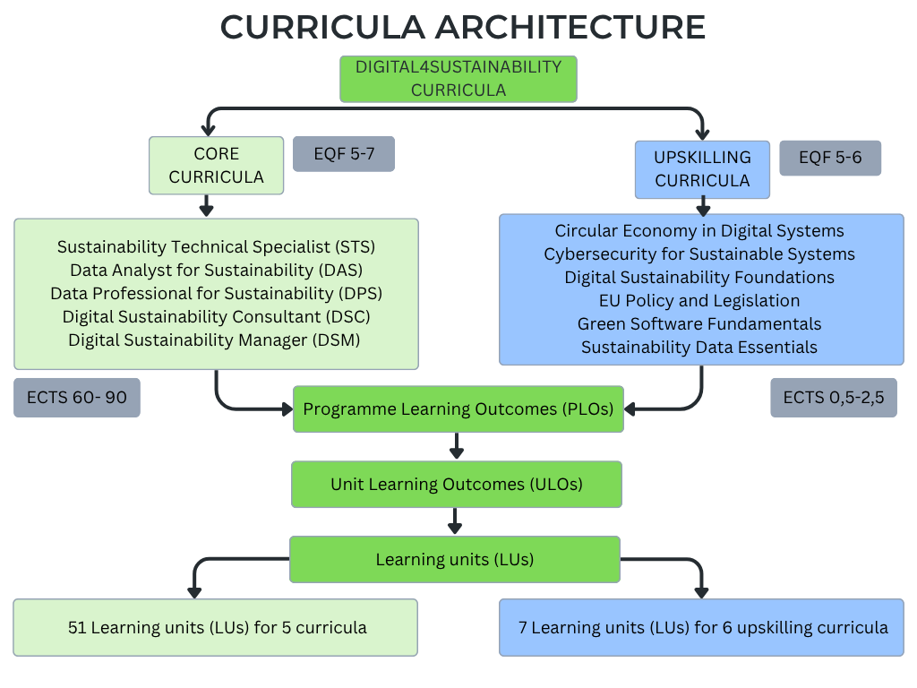
Curriculum Architecture
Notes:
The curricula are organised into two complementary components. First, the Core Curricula provide comprehensive, long-term learning pathways for specific professional roles. Second, the Upskilling Curricula are short, targeted programmes designed for professionals who need to develop specific competencies rapidly. Both are aligned with the European Green Deal and the Digital Decade 2030 goals.

Slide 4
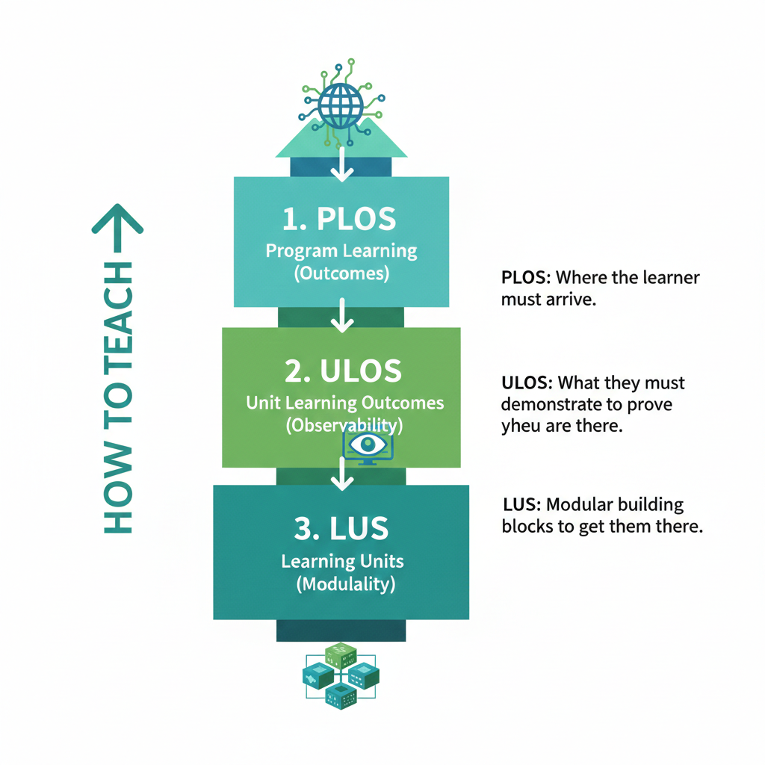
Three Structural Elements
PLOs: Where the learner must arrive
ULOs: What they must demontrate to prove you are there
LUs: Modular building blocks to get them there
Notes:
Every curriculum is built on three pillars. Think of it this way: The Programme Learning Outcomes (PLOs) define the final destination—what a learner knows at the end of a full programme. The Unit Learning Outcomes (ULOs) are observable achievements for each unit. Finally, the Learning Units (LUs) are the actual modular blocks we deliver to reach those outcomes.

Slide 5
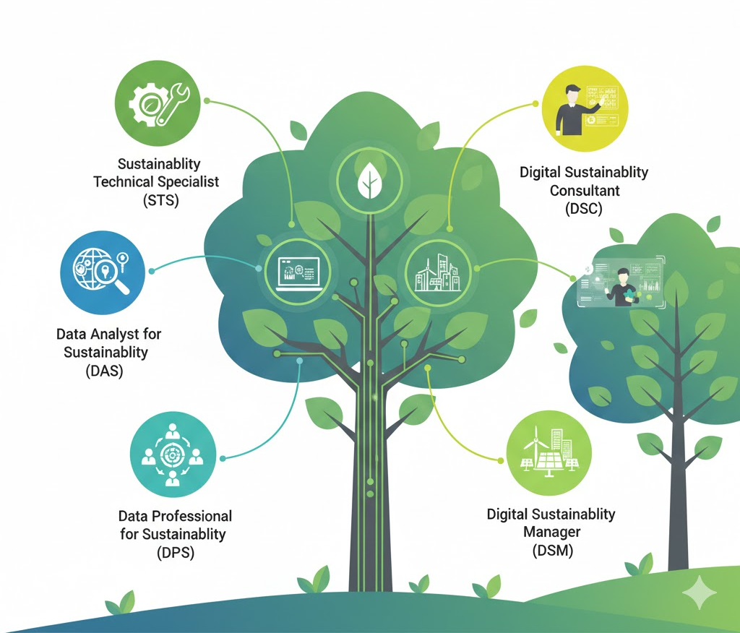
Five educational profiles (EQF 5-7)
Sustainability Technical Specialist (STS) – EQF 5
Data Analyst for Sustainability (DAS) – EQF 6
Data Professional for Sustainability (DPS) – EQF 7
Digital Sustainability Consultant (DSC) – EQF 7
Digital Sustainability Manager (DSM) – EQF 7
Notes:
We have developed five distinct profiles to address different market needs. It’s important to note the different EQF levels: the Technical Specialist starts at level 5, focusing on implementation and maintenance, while the Analyst, Professional, Consultant, and Manager roles reach levels 6 and 7, focusing on strategic advisory and complex data modelling.

Slide 6

Six Upskilling Curricula (EQF 5-6)
Circular Economy in Digital Systems
Cybersecurity for Sustainable Systems
Digital Sustainability Foundations
EU Policy and Legislation
Green Software Fundamentals
Sustainability Data Essentials
Page 6
Notes:
For professionals who cannot commit to a full degree, we offer six upskilling curricula. These are extracted from the core units and focus on immediate workplace applicability. As trainers, your priority here is flexibility and rapid capability development.

Slide 7
European Competence Frameworks
e-CF
GreenComp
EQF
EQF: Defines depth, complexity, and autonomy (Levels 5, 6, 7).
e-CF: Provides the structure for digital and IT competences.
GreenComp: Defines transversal sustainability competences like systems thinking.
Page 7
Notes:
Our curricula don't exist in a vacuum. They are mapped against three major EU frameworks. The EQF guides the sophistication of learning; the e-CF ensures our digital skills meet European IT standards; and GreenComp integrates values like futures literacy and action-oriented thinking. This ensures that the skills learners acquire are transparent and portable across Europe.

Slide 8
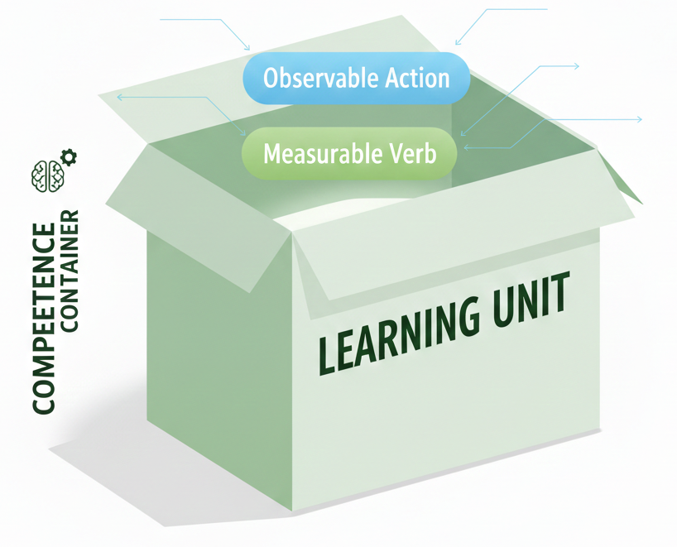
Key Takeaways for Trainers
Alignment: Frameworks clarify the required level of learner autonomy.
Assessment: Focus on competence (performance), not just content (theory).
Flexibility: LUs can be delivered as standalone units or grouped.
Rule: If a learner cannot produce an observable outcome, the goal isn't met.
Page 8
Notes:
What does this mean for you? First, the frameworks tell you how much autonomy to expect from the learner. Second, your assessment must focus on what the learner can do, not just what they can remember. Finally, remember that these units are modular—you can deliver a single unit or combine them into a custom pathway, provided the ULOs remain unchanged.

Slide 9
Thank you for your time
Notes:
This concludes our overview of the curriculum architecture. In the next module, we will dive deeper into the core building blocks: the Learning Units and their specific outcomes. Thank you for your time.

