Slide 1
Module 3: Pedagogical Foundations
Notes:
Welcome to Module 3. This is perhaps the most important module for your daily work as a trainer. We are moving away from the traditional model of "content transmission"—where the trainer just speaks—towards "competence development," where the learner actively builds capability.

Slide 2
The Four Pillars: Adult Learning, Competence-Based, Active Learning, and Constructive Alignment.
Adult Learning (Andragogy): Activating prior knowledge.
Competence-Based Learning: Focusing on observable evidence.
Active Learning Toolbox: Practical micro-methods for your sessions.
Constructive Alignment: Connecting outcomes, activities, and assessment.
EQF Adaptation: Adjusting levels of autonomy
Notes:
In this module, we will explore the four fundamental pillars of our pedagogical approach. We will look at how adults learn best, what it means to teach based on competence rather than theory, and we will provide you with a practical "Toolbox" of methods you can use immediately.

Slide 3
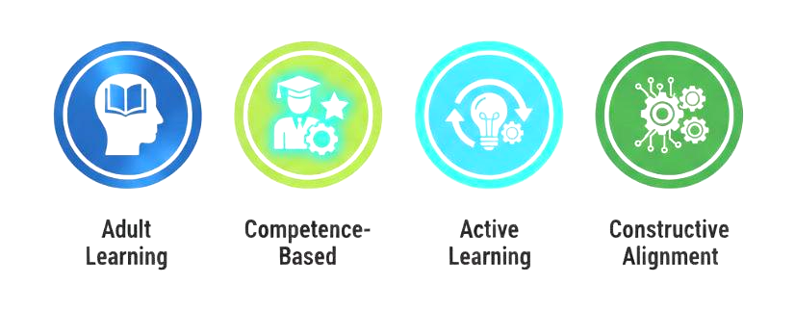
The Four Principles of Modern Education
"We don't just transfer knowledge,
we build capability."
Notes:
Our approach is grounded in these four established educational frameworks. We use Knowles’ Andragogy for adult engagement, Mulder’s research for competence, Prince’s work for active strategies, and Biggs’ model to ensure that our lessons, activities, and assessments are perfectly aligned.

Slide 4
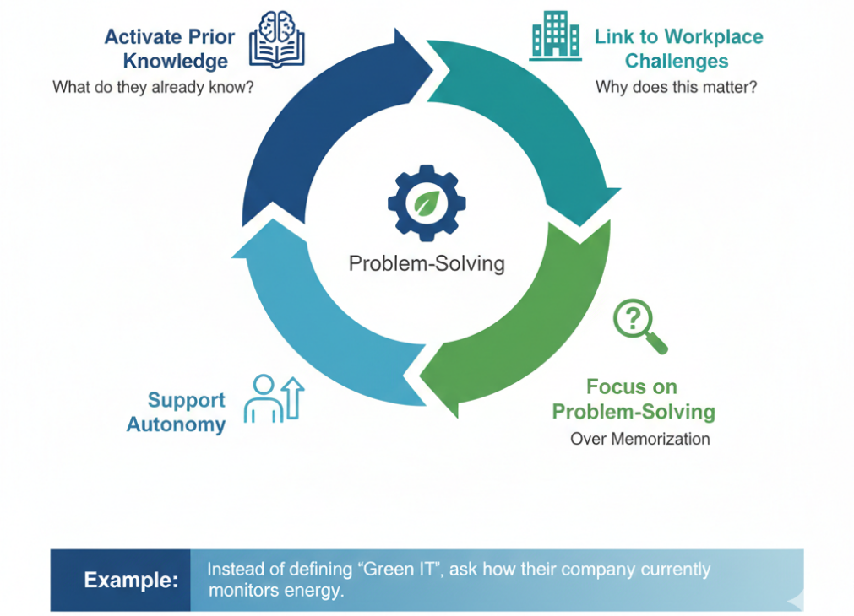
Adult Learning Orientation (Knowles, 1984)
Notes:
Adult learners bring a wealth of experience. Our role is not to ignore that experience, but to activate it. We don't just give them definitions; we present them with workplace challenges. We want them to solve real problems, which is far more effective for long-term retention than simple memorization.

Slide 5
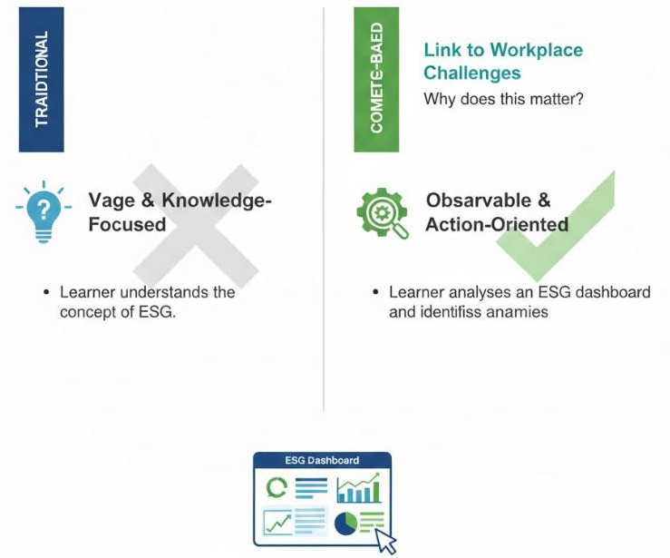
Competence-Based Learning (Mulder, 2017)
Traditional: Knowledge-focused (Learner understands the concept of ESG).
Competence-Based: Action-oriented (Learner analyses an ESG dashboard and identifies anomalies).
The Golden Rule: If learners cannot produce an observable outcome, the competence has not been achieved
Learner understands the concept of ESG
Learner analyses an ESG dashboard and identifies anomalies
Notes:
In a traditional setting, we might be happy if a student can explain what a carbon footprint is. In our programme, that's not enough. They must be able to calculate it or analyse a report to find improvements. Remember our Golden Rule: learning is only confirmed through observable performance.

Slide 6





The Micro-Methods Toolbox
Micro Lectures
Concept Framing
(5-10 min)
Case Miniature
(Short) Linking Theory to practice
Guided Data Task
Developin analytic competence
Scenario Challenge
Applying judgement
Consolidating learning
Mini-Project
Notes:
To help you deliver this, we’ve created a "Micro-Methods Toolbox." You don't need to use all of them in every session. Choose the one that fits your ULO. A micro-lecture is great for framing a concept, but a scenario challenge is better when you want learners to exercise professional judgement.

Slide 7
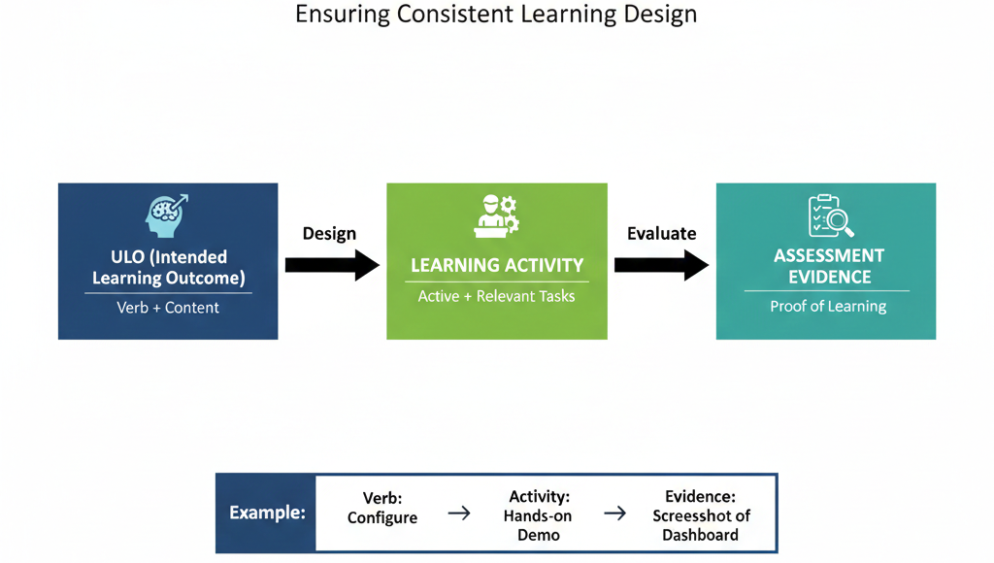
Constructive Alignment (Biggs, 1996)
Notes:
Constructive Alignment is about logic. If your intended outcome is for a student to "Design" something, you cannot assess them with a multiple-choice quiz. The activity and the assessment must match the verb in the ULO. We always design backwards: start with the goal, define the evidence, then create the task.

Slide 8
Adapting to EQF Levels
EQF 5
Structured tasks, guided practice
(Trainer demonstrates).
EQF 6
Analysis, interpretation, comparison
(Trainer facilitates).
EQF 7
Strategic reasoning, synthesis, judgment
(Trainer challenges).
Core Principle: Adapt the support
level but keep the ULO unchanged.
Notes:
As a trainer, your role shifts depending on the EQF level. At Level 5, you are a demonstrator, providing a lot of "scaffolding." At Level 7, you are a challenger, pushing learners to think strategically and work with high autonomy. The goal is to adapt the pathway, but the destination—the ULO—remains the same for everyone.

Slide 9
Supporting Diverse Learners
Universal Design for Learning (UDL): Providing multiple ways to engage.
Clarify Expectations: Start every LU by explaining the goal.
Scaffold Skills: Provide extra help for digital tools if needed.
Stretch Tasks: Provide additional challenges for advanced learners.
Notes:
Our learners come from managerial, technical, and sustainability backgrounds. To support this diversity, we use Universal Design for Learning. This means we provide "scaffolding"—temporary support—for those who struggle with new tools, and "stretch tasks" for those who are already experts and need more challenge.

Slide 10

Module 3 Summary Checklist
Focus on what learners do, not just what you say.
Use the Micro-Methods Toolbox to vary your delivery.
Ensure Constructive Alignment between ULOs and Evidence.
Adjust your role (Demonstrate vs. Challenge) based on EQF levels.
Notes:
To summarize Module 3: keep the learner active. Use our toolbox to design your sessions, and always make sure your activities are aligned with the action verbs in the ULOs. Your primary goal is to help the learner produce the evidence required to prove their new competence.

Slide 11
Thank you for your time
Notes:
Thank you for your time. In the next module, we will put these foundations into practice by looking at the specific workflow of delivering a Learning Unit.

