Slide 1
Module 4: Delivering Learning Units Effectively
Notes:
Welcome to Module 4. Now that we have the pedagogical foundations from Module 3, it’s time to look at the practical workflow. This module is your "road map" for taking a Learning Unit from a document and turning it into a real, engaging classroom experience.

Slide 2
Step 0: Analyzing your Learning Unit (LU).
The Trainer Workflow: From ULO to Delivery Plan.
Session Sequencing: A proven 5step pattern.
Assessment Strategy: Focusing on lightweight, tangible evidence.
The Lesson Plan Template: Operationalizing your session.
Contextualization: Adapting to VET, Higher Ed, and Industry.
Notes:
We will guide you through the entire process: starting with the analysis of your assigned unit, moving through the design workflow, and finally looking at how to fill out the mandatory Lesson Plan Template. We will also discuss how to adapt your style to different learner backgrounds.

Slide 3
Step 0: Analyzing Your Learning Unit
Identify the LU & Read ULOs: Focus on action verbs.
Review Learning Material Packs (LMP): Check existing guides and tasks.
Determine Content Depth: Refer to EQF level (5, 6, or 7).
Clarify Scope: Remember, the LU defines competence, not just a list of topics.
Trainer Shortcut: If you cannot describe in one sentence what learners must produce at the end, you don't yet understand the Unit.
Notes:
Before you plan any activity, you must deconstruct the unit. Look at the action verbs in the unit learning outcomes—they tell you exactly what the learner’s behavior should be. Check the Learning Material Packs provided by the project, as they contain the specific assessment instruments you should use.

Slide 4
The 4-Step Trainer Workflow
Read the ULO(s): Identify the key action verb.
Choose an Active Method: Select a micro-method from Module 3 that matches the verb.
Define Assessment Evidence: Decide exactly what the learner will produce.
Sequence the Session: Structure the flow from activation to reflection
Read the ULO(s)
Choose an Active Method
Define Assessment Evidence
Sequence the Session
Notes:
This 4-step workflow is your conceptual design phase. Always start with the unit learning outcomes. If the verb is "Configure," your active method should be a "Hands-on Demo," and your evidence should be a "System Screenshot." Don't design activities in a vacuum; let the unit learning outcomes lead the way.

Slide 5
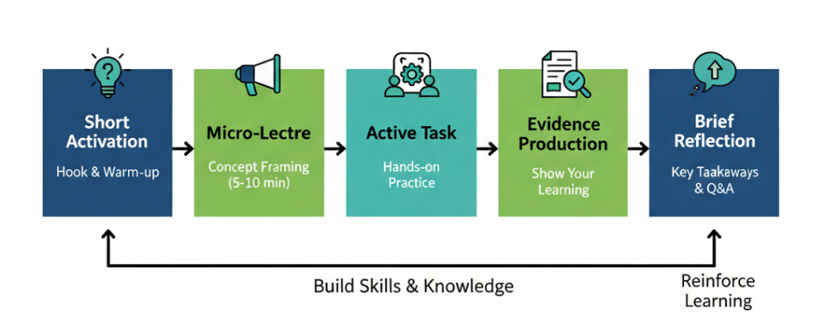
Sequencing a Typical Session
Short Activation: Activate prior knowledge (Hook).
Micro-Lecture: Concept framing (5–10 mins).
Active Task: The core activity (Aligned with ULO).
Evidence Production: Creating the tangible output.
Brief Reflection: Consolidate learning and discuss application.
Tip: If your activity creates the evidence needed for assessment, the LU is correctly aligned.
Notes:
A typical Digital4Sustainability session follows this 5-step pattern. It ensures that students aren't just listening—they are doing.
The most important part is Step 4: Evidence Production.
This is where the student proves they have met the learning outcome.

Slide 6
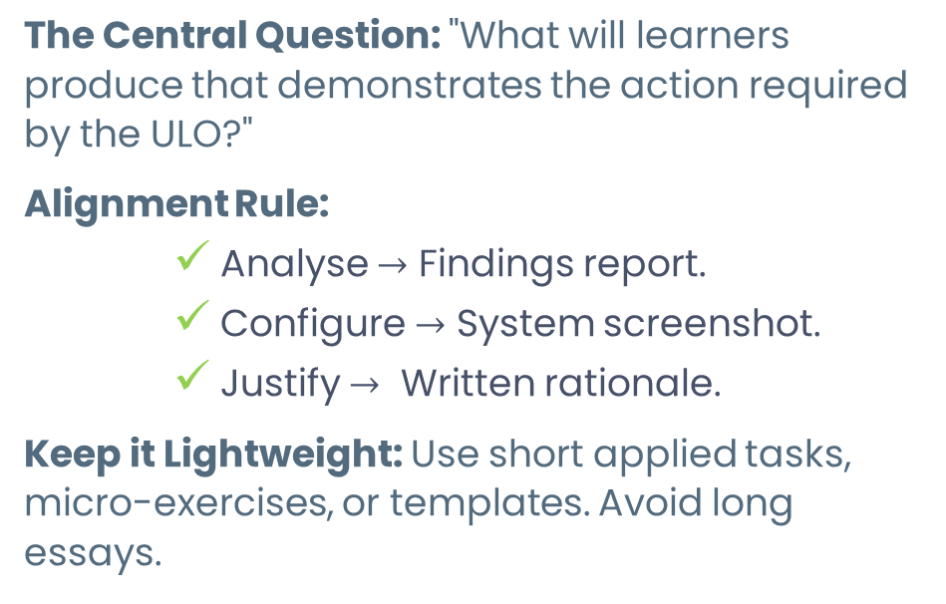
Assessment: The Central Question
Leightweight & Applied (Effective)
Traditional
(Heavy)
Long Essays
Short Applied tasks
Micro Exercises
The Central Question: "What will learners produce that demonstrates the action required by the ULO?"
Alignment Rule:
    Analyse $→$ Findings report.
    Configure $→$ System screenshot.
    Justify $→$ Written rationale.
Keep it Lightweight: Use short applied tasks, micro-exercises, or templates. Avoid long essays.
Notes:
In our approach, assessment is an integral part of learning design, not an extra exam at the end. We focus on short, observable outputs produced during the session, rather than lengthy essays.
The central rule is: The evidence must mirror the ULO verb. If a learner must 'Analyse,' they produce an analysis; if they must 'Configure,' they produce a screenshot or system export.
For the Pilot Phase:
We use a 'Pass/Fail' model based on whether the produced evidence aligns with the ULO.
Check your Learning Material Pack (LMP): All specific assessment instruments and criteria are found there to ensure consistency.
Two-Track approach: For single units, prioritize lightweight artifacts (short tasks, digital quizzes, or mini-reflections). For the full curriculum, follow the comprehensive project requirements (like a Capstone) specified in the LMP.
Keep evidence collection manageable: focus on tangible artifacts that directly confirm competence."

Slide 7
The Lesson Plan Template
The Lesson Plan Template is your script for delivery.
Mandatory for Pilot Phase: Ensures consistency across all partners.
Key Fields:
Target ULOs.
Teaching Methods.
Evidence Type (Tangible output).
Timing & Sequence.
Materials/Tools required.
Applying judgement
Consolidating learning
Mini-Project
Notes:
You will find the Lesson Plan Template in the Annex of your Handbook. Filling this out is a requirement for the pilot phase. It serves as your delivery script, ensuring that no matter who is teaching in Spain, the Netherlands, or Croatia, the learning outcomes remain comparable.

Slide 8
Contextualizing Across Learning Environments
VET Settings: More structure, concrete examples, and step-by-step modeling.
Higher Education: Analytical depth, comparative reasoning, open-ended tasks.
Workplace/Industry: Immediate applicability, real organizational cases, and decision-making.
Core Principle: Adapt the learning pathway and support level, but keep the ULOs unchanged.
Notes:
Our curricula span EQF levels 5 to 7 and are designed to be delivered across VET, Higher Education, and Industry settings. To do this effectively, you must contextualise.
The Golden Rule: You may adapt the pathway, the examples, and the level of scaffolding, but the Unit Learning Outcomes (ULOs) must remain unchanged.
Best Practices:
Conduct a Pre-assessment: Use a brief questionnaire before the session. This establishes a baseline of your learners' prior experience.
Demonstrate Learning Gain: By comparing this baseline with the final evidence produced, you can clearly demonstrate the 'learning gain' achieved during your session.
Tailor your Support:
In VET: Use more structure and step-by-step modelling.
In Higher Ed: Focus on analytical depth and critical reflection.
In Industry: Focus on immediate workplace applicability and real organisational datasets.
Remember, you are adjusting the support level and the scenarios to fit the learners' professional reality, but they must still prove the same performance level required by the curriculum

Slide 9
Module 4 Summary Checklist
Analyze first: Understand your ULOs and EQF level.
Plan the flow: Activation → Activity → Evidence.
Define evidence: Ensure learners produce something observable.
Use the Template: It is your roadmap for a successful pilot
Notes:
To wrap up: Always start with the ULO, not the slides. Use the 5-step sequence to bridge the gap between theory and action. If your activity reliably generates the evidence required, your delivery is aligned. Finally, treat the Lesson Plan Template as your professional roadmap—it’s what turns a good idea into a successful pilot.

Slide 10
Thank you for your time
Notes:
Thank you for completing Module 4. In the next module, we will focus on the administrative side—how to collect that evidence and report it correctly for the project validation.

