Slide 1
Module 5: Assessment and Pilot Reporting
Notes:
Welcome to Module 5. This module focuses on two distinct but related goals: first, how we assess whether learning has happened, and second, how we report that data to the project. For those involved in the pilot phase, this is the most critical administrative part of your role.

Slide 2
The Big Picture: Why evidence matters.
Assessment vs. Reporting: Defining the difference.
The Minimum Evidence Set: The 5 mandatory items.
Evidence Criteria: Quality and visibility.
Special Cases: Asynchronous/Self-paced reporting.
Roles & Responsibilities: The reporting chain.
Notes:
We will start by explaining why we collect evidence—it’s not just paperwork; it’s about validating our entire curriculum. We will then go through the "Minimum Evidence Set" required for every pilot session and discuss the specific criteria for high-quality documentation.

Slide 3
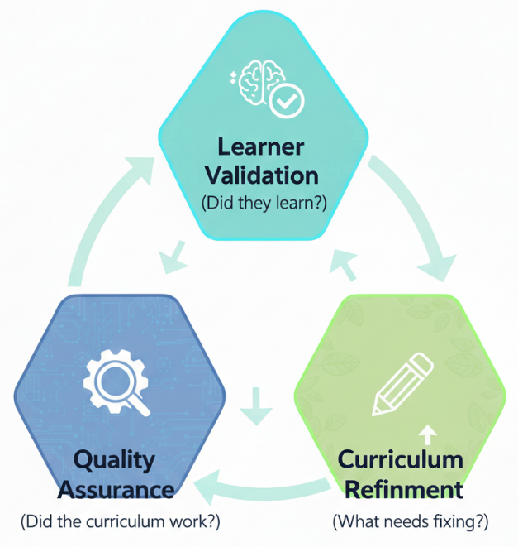
Why Evidence Collection Matters
Learner Validation: Confirming outcomes.
Quality Assurance: Proving the curriculum works.
Curriculum Refinement: Constant improvement based on real data.
Notes:
n this project, evidence is much more than paperwork—it is our primary tool for validation. First, it validates the Learner (did they actually reach the ULO?). Second, it validates our Quality Assurance (is the Learning Unit effective in different countries?). And third, it drives Curriculum Refinement. We are building a scalable European ecosystem, and your data tells us exactly where the gaps are. We move from assumptions to evidence-based education.

Slide 4
Assessment vs. Reporting
Educational Assessment: The "What" and "How" of testing (Quizzes, Tasks, Capstone). Focuses on the learner's skill.
Pilot Reporting: The "Administrative Proof" required for project verification. Focuses on the process and artifacts.
Key Insight: You need the Assessment results to complete the Reporting.
Notes:
It is vital to distinguish between these two concepts. Educational Assessment is what you do in the classroom to check if the student learned. Pilot Reporting is what you do after the classroom to prove to the European Commission and the project coordinators that the session took place and followed the methodology. One is about the student’s success; the other is about the project’s compliance. This module ensures you succeed in both

Slide 5
The Minimum Evidence Set (Mandatory)
Attendance Records
Completed Lesson Plan
Learner Evidence Artefacts (Screenshots, reports, etc.)
Learner Feedback Forms
Trainer Reflections (Your feedback)
Note: If any of these are missing, the session cannot be validated for the project pilot.
Notes:
To ensure consistency across the 13 countries in our consortium, we require a 'Minimum Evidence Set.' You must collect all five items. Notice that Trainer Reflections are now mandatory. Your professional opinion on whether a Learning Unit was too difficult or the materials were unclear is the most valuable data we have for the final version of the curricula. Without these five items, a pilot session cannot be officially validated.

Slide 6
Valid Evidence vs. Participation
VALID EVIDENCE | NOT EVIDENCE
Short Action Plan Screenshot of configuration Written justification of a KPI Completed worksheet | Student listened to lecture Group had a discussion Student said they understood
If it’s not visible, it’s not evidence!
Notes:
This slide represents the core of our quality control. We must distinguish between 'participation' and 'performance.' A student who is present and engaged is doing well, but that is not evidence of learning for reporting purposes. We need a 'traceable artifact.' For example, if you conduct a workshop where students discuss ESG indicators, don't just report that they talked—have them fill out a simple worksheet or write a one-paragraph conclusion. That physical or digital artifact is what we archive as proof of competence

Slide 7
Criteria for
Documentation
Criteria for Documentation
VISIBLE: Trainers must be able to show what the learner did.
TRACEABLE: It must connect to a specific Unit Learning Outcome (ULO).
LIGHTWEIGHT: Short, focused, and authentic (avoid lengthy academic essays).
REUSABLE: Suitable for review, feedback, and reporting.
Lightweight Tip: Focus on artifacts produced during the session, not extra exams.
Notes:
Documentation should follow these four criteria. It must be Visible (as discussed), Traceable (clearly linked to a specific ULO verb), Lightweight (we prefer a short 3-sentence rationale over a 20-page essay), and Reusable. Reusability means the data is clean and structured enough so that our curriculum teams can analyze it months from now to improve the module's design."

Slide 8
Special Case - Asynchronous/Self-Paced Delivery
Role: Content Administrator (instead of Trainer). Specific Evidence: User Access Logs (Proof of access). Completion Artefact (Screenshot of summary/results). Standardized Online Survey (Feedback).
Notes:
"Reporting for self-paced delivery (like the IZZI platform) is different because there is no live trainer to collect artifacts. Here, the 'Content Administrator' takes over. We rely on automated data: logs that prove the learner logged in and screenshots of their final score or summary screen. This ensures that even without a teacher present, the quality and completion of the module are verified."

Slide 9
Assessment Standards & Thresholds
Pilot Phase Model: Pass/Fail.
Threshold: A minimum of 60% for automated exams.
Summative Assessment: Detailed tasks and rubrics are found in the Learning Material Packs (LMP).
Formative Assessment: Continuous feedback during activities.
Applying judgement
Consolidating learning
Mini-Project
Notes:
For the pilot phase, we use a 'Pass/Fail' model. However, to ensure a European standard of quality, we've set a minimum threshold of 60% for any automated quizzes or exams. For more complex delivery, like full profiles, you must use the specific rubrics found in the Learning Material Packs (LMP) to determine if a learner's project meets the required competence level.

Slide 10
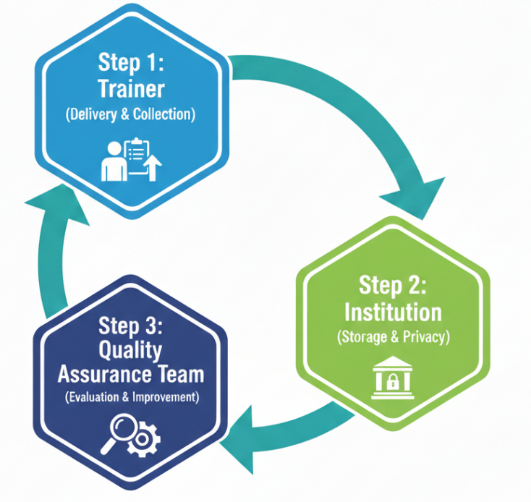
Roles & Responsibilities
Trainer: Delivers, collects evidence, ensures feedback forms are completed.
Institution: Stores documentation and ensures GDPR compliance.
Piloting Partner: Aggregates and analyses implementation data.
Curriculum Teams: Use findings to improve the modules.
Notes:
Quality reporting is a chain of responsibility. The Trainer collects the raw data and removes sensitive personal info. The Institution stores it securely and ensures GDPR compliance. Finally, the QA and Coordination team aggregates everything to validate the project's impact. If one link in this chain fails, the entire pilot data becomes unreliable. Your accuracy at Step 1 is vital for the whole consortium.

Slide 11
Module 5 Summary Checklist
Collect visible artifacts for every ULO.
Use the standardized templates (Lesson Plan, Feedback).
Ensure GDPR compliance (minimize personal data).
Provide your Trainer Reflections for improvement.
Notes:
To conclude: your reporting is what makes this project "real" for the European Commission. Follow the templates, keep the evidence visible, and remember that your reflections are just as important as the students' results.

Slide 12
Thank you for your time
Notes:
Thank you for your attention to these administrative details. In the next module, we will look at the actual "Learning Material Packs" and resources you have at your disposal for your training sessions.

