Slide 1
Module 6: Training Materials and Digital Resources
Notes:
Welcome to Module 6. In this session, we will explore the actual "tools of the trade." We will look at the various materials we have developed for you, where to find them, and how you can adapt them to your specific local context while maintaining the quality standards of the project.

Slide 2
Design Philosophy: Lightweight, modular, and platform-independent.
The Trainer Handbook: Your primary navigation tool.
Learning Material Packs (LMP): Two distinct models of delivery.
Templates & Checklists: Ready-to-use daily tools.
Localization: What you can change and what must stay the same.
The Resource Hub: Accessing the central repository.
Notes:
Our goal for this module is to ensure you know exactly what resources are available. We will discuss our design philosophy, go over the specific types of Learning Material Packs we’ve created, and explain the rules for localizing these materials for your country or sector.

Slide 3
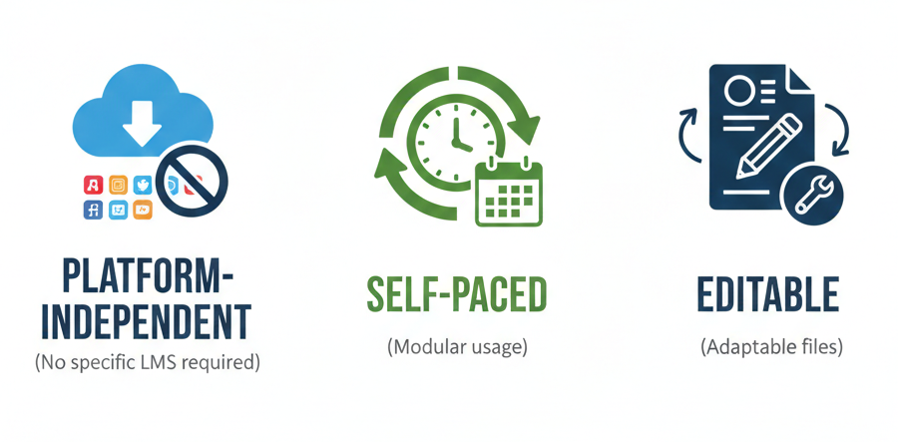
Design Philosophy: Lightweight & Flexible
Notes:
We intentionally designed these materials to be "lightweight." This means they are not locked into one specific platform or software. Whether you use Moodle, Microsoft Teams, or simple printed handouts, these resources are designed to work for you without technical barriers.

Slide 4
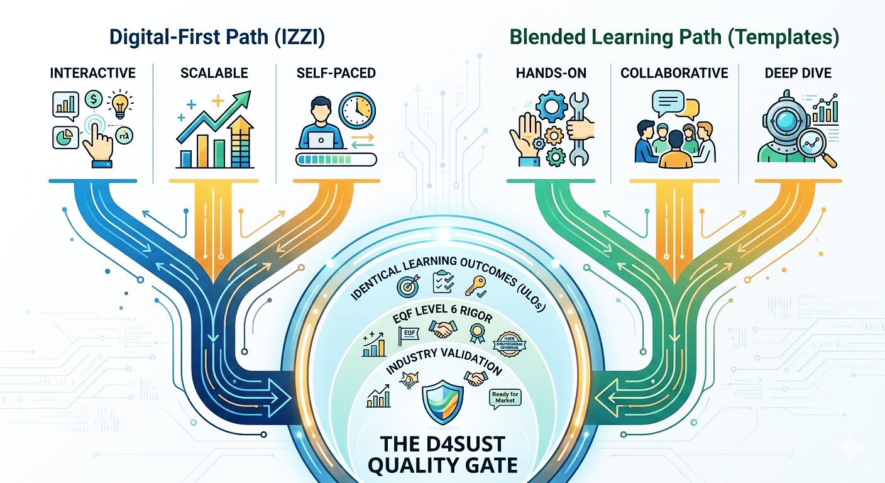
Learning Material Packs (LMP) – Two Models
Notes:
This is a critical update for your planning. We have developed two distinct delivery models based on the complexity of the topic.
Model A (Digital-First) is for foundational units like EU Policy. These are hosted on the IZZI platform and are designed for high-volume, automated learning with self-check quizzes.
Model B (Blended Learning) is for 'heavy' units like Circular Economy or Green Software. These units require deeper competence, so we provide a full 'Four-Pillar' package: a Student Handbook for theory, a F2F Guide for workshops, PBL tasks for workplace application, and Videos for expert insights. Always check which model your assigned Learning Unit follows before you start planning."

Slide 5
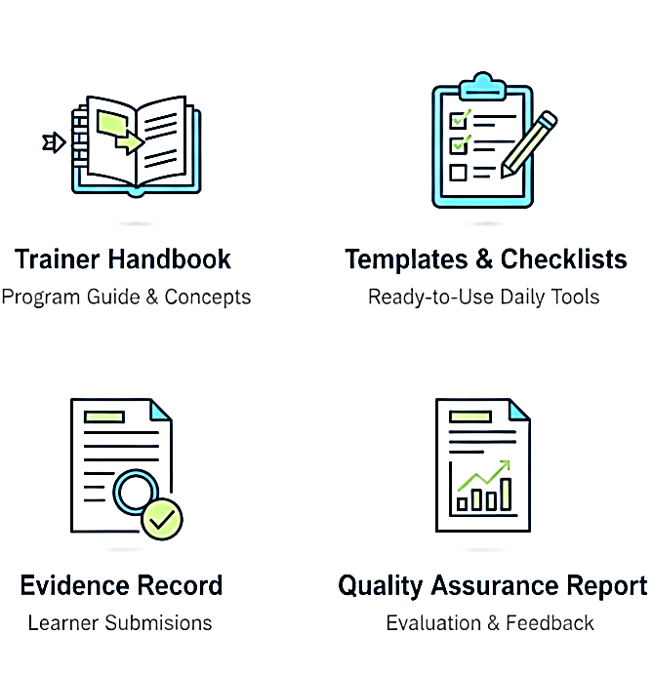
Essential Templates (Ready-to-Use)
Annex 1. Lesson Plan Template (Planning)
Annex 2. Trainer Preparation Checklist (Readiness)
Annex 3. Delivery Checklist (Reporting & Reflection)
Annex 4. Learner Feedback Form (Evaluation)
Note: All templates can be provided in editable .docx format for easy localization and translation.
Note: Annex 4 is available in two versions: Annex 4 (Synchronous) and Annex 4a (Asynchronous).
Applying judgement
Consolidating learning
Mini-Project
Notes:
You will notice that we repeatedly emphasize these templates throughout the TTT programme. We do this because these documents are the only official proof that your pilot session actually took place. Without this specific set of documentation, the project coordination team cannot validate your work or report it to the European Commission.
Please use these exact titles found in the Annexes of your handbook:
Annex 1. Lesson Plan Template: Your primary tool to map ULOs to activities. It proves your pedagogical strategy.
Annex 2. Trainer Preparation Checklist: Your 'readiness' guide to be completed before the session.
Annex 3. Delivery Checklist: To be completed immediately after delivery. Crucial Note: This document also includes the Trainer Reflection section, which is a mandatory part of our evidence set.
Annex 4. Learner Feedback Form: Used for live, synchronous workshops.
Annex 4a. Learner Feedback Form: Specifically for self-paced or asynchronous delivery via the IZZI platform.
All these templates are provided in editable .docx format. We encourage you to translate them into your local language and adapt the examples, but you must keep the structure and the questions identical. Consistency is what allows us to compare results from 13 different countries and prove the success of the Digital4Sustainability project."

Slide 6
Localization & Adaptation (Do's and Don'ts)
ADAPT
Case examples & scenarios.
Language (Translation).
Delivery format (Online/Blended).
Specific software tools.
KEEP
Unit Learning Outcomes (ULOs).
Core Assessment Criteria.
Key Principle: Adapt the "how," but never the "what."
Notes:
Localization is highly encouraged, but it has strict boundaries. You SHOULD adapt the context: use local case studies, translate the terminology, and choose software tools that are common in your country. This makes the learning relevant.
However, there is a Red Line: you must NEVER change the Unit Learning Outcomes (ULOs) or the core assessment criteria. These are the fixed standards of the Digital4Sustainability project. If you change the 'What' (the outcome), the training is no longer valid for the project. Adapt the 'How,' but keep the 'What' identical across all countries."

Slide 7

The Online Resource Hub
Applying judgement
Consolidating learning
Mini-Project
Central access point.
Includes: trainer handbook, templates and videos.
User-friendly (No login barriers).
Notes:
The Online Resource Hub is your primary source for updates. While the main handbooks are public, some resources—like the editable Word templates—may be housed in a secure partner area. Make sure you have the latest versions before you start your pilot delivery.

Slide 8
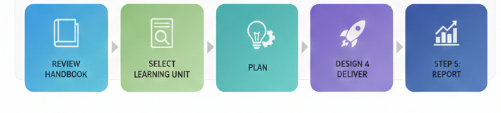
Recommended Workflow for Trainers
Review Handbook: Understand the curricula logic.
Identify Learning Unit: Know exactly which LU you are delivering.
Plan: Use the Lesson Plan Template to align activities with ULOs.
Deliver: Use the pedagogical strategies from Module 3.
Report: Collect evidence and submit documentation as per Module 5.
Applying judgement
Consolidating learning
Mini-Project
Notes:
To wrap up, follow this 5-step sequence to guarantee success. First, read the Handbook to understand the project’s DNA. Second, identify your specific LU and check its delivery model (IZZI or Blended). Third, use the Lesson Plan template to map out your session. Fourth, deliver using the active methods from Module 3. And finally, don't forget to collect the 5 items of the 'Minimum Evidence Set' for your report. This workflow ensures that your delivery is professional, aligned, and easy to validate."

Slide 9
Module 6 Summary & Transition
Resources are tools, not rules (adapt them as needed).
Adapt the context, but always keep the outcomes.
Notes:
Remember, these resources are here to support you, not to limit you. Be creative with your examples and context, but stay true to the intended learning outcomes.

Slide 10
Thank you for your time
Notes:
Thank you for completing Module 6. In our final module, we will look at the Trainer Competency Framework, which will help you self-assess your readiness to deliver these units.

