Slide 1
Module 7: Trainer Competency Framework
Notes:
Welcome to our final module, Module 7. High-quality delivery depends not just on well-designed materials, but on the trainers who facilitate them. This module introduces the Trainer Competency Framework—a reference standard to help you prepare and excel in your role as a Digital4Sustainability trainer.

Slide 2
The Purpose: A reference standard for self-assessment (not a certification).
The 5 Core Competency Areas: From pedagogy to sustainability.
Competencies per LU Type: Matching your skills to the specific unit.
Self-Assessment: Reflection prompts to gauge readiness.
Post-TTT Capabilities: What you can do after finishing this programme.
Notes:
In this module, we will explore five core areas of competence. We’ll also look at how different types of Learning Units require different focus areas. Finally, we will provide you with a set of self-assessment prompts so you can feel confident before stepping into the classroom or starting your online sessions.

Slide 3
Purpose of the Framework
Reference Standard: Defines what a trainer should demonstrate for consistent delivery.
Self-Paced Readiness: Helps you identify your own development needs.
Alignment: Ensures practice meets the expectations of the Digital4Sustainability programme.
Note: This is a tool for growth, not a formal exam.
Consolidating learning
Mini-Project
Notes:
It is important to clarify how this framework should be used. Think of it as a professional reference standard rather than a formal testing mechanism. Its primary goal is to provide you with a clear benchmark so you can assess your own readiness before stepping into the classroom or starting an online session.
We encourage you to use this framework to honestly identify your strengths and recognize any areas where you might need a little more preparation. For example, if you are a sustainability expert but feel less confident with the digital tools, this framework helps you see that gap early. You can then spend more time with Module 6 or perhaps arrange for co-teaching support from a colleague with a stronger IT background.
Ultimately, this tool is here to support your success and ensure that every learner in every country receives the same high level of expertise

Slide 4
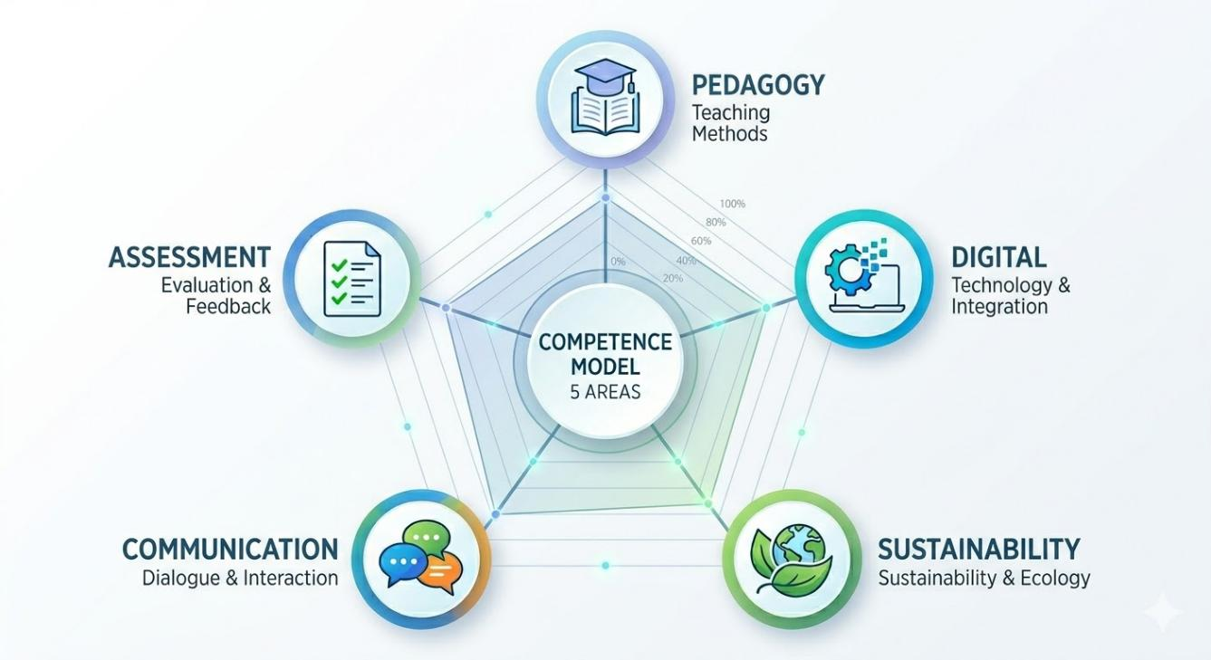
Core Area 1: Pedagogical Competence
Ability to:
Plan sessions aligned with ULOs.
Apply active, learner-centred methods.
Facilitate mixed-experience groups.
Guide reasoning (don't just present info).
In Practice: Moving from "talking at" students
to "doing with" students.
Mini-Project
Notes:
Pedagogical competence in this project is not about your ability to lecture for hours. It is about your ability to facilitate. Our framework focuses on moving from 'talking at' students to 'doing with' students. This means you should be comfortable managing groups where some learners have more experience than others, guiding them to find answers through the active methods we practiced in Module 3. Your role is to be the 'architect' of the learning experience, ensuring that every activity directly supports the Unit Learning Outcome (ULO)."

Slide 5
Core Area 2 & 3: Digital & Sustainability
Digital Competence (DigComp 2.2):
Navigating the digital tools used in the LU.
Supporting learners with varying levels of digital readiness.
Sustainability Competence (GreenComp):
Connecting digital decisions to environmental consequences.
Promoting systems thinking and ethical discussions.
In Practice: Contextualizing digital choices within a green strategy.
Consolidating learning
Mini-Project
Notes:
This is where the 'Twin Transition' comes to life. A Digital4Sustainability trainer needs to bridge the gap between technology and the environment. You don't need to be a coding expert or a climate scientist, but you must be able to explain why a specific digital tool (like a cloud server) has an impact on sustainability (like energy consumption). The goal of this competency area is to ensure you can lead learners through ethical discussions about technology's role in a greener future

Slide 6
Core Area 4 & 5: Professionalism & Assessment
Professional & Communication Skills:
Facilitating discussions and managing learner expectations.
Providing concise, constructive feedback.
Assessment & Evidence Competence:
Selecting appropriate evidence types aligned with ULO verbs.
Ensuring artifacts are produced and captured correctly.
In Practice: Ensuring "meaning-making" and traceable results.
Consolidating learning
Mini-Project
Notes:
Area 4 focuses on your role as a professional communicator—managing time, expectations, and providing the kind of constructive feedback that helps adults grow. Area 5, however, is your 'compliance' tool. It links back to Module 5. You must be competent in identifying traceable evidence. A competent trainer knows exactly which student output proves the ULO has been met and ensures that this artifact is captured in the correct format for our project reporting

Slide 7
Requirements per Learning Unit Type
Technical LUs: Focus on digital competence + hands-on guidance.
Data-oriented LUs: Focus on data literacy + interpretive skills.
Policy & Regulatory LUs: Focus on sustainability and compliance understanding.
Managerial/Strategic LUs: Focus on stakeholder engagement + decision-making.
Consolidating learning
Mini-Project
Notes:
We recognize that no trainer is an expert in everything. This slide helps you understand where to focus your preparation depending on your assigned unit. If you are delivering a Technical LU, you must double-check your digital troubleshooting skills. If you are leading a Managerial LU, your focus shifts to facilitating decision-making and stakeholder engagement. Use this table to decide if you need extra preparation time or perhaps a co-trainer to balance your skills.

Slide 8
Self-Assessment: Are you ready?
Can I clearly explain what the ULO requires the learner to demonstrate?
Can I select at least one active method aligned with the ULO verb?
Am I able to collect meaningful evidence within the time available?
Do I feel confident troubleshooting the basic digital tools for this unit?
If you can answer YES to these, you are ready to deliver!
Consolidating learning
Mini-Project
Notes:
This is your final green light. This self-assessment is not a test you can fail; it is a tool for your own professional confidence. If you can answer 'yes' to these questions, it means you have internalized the logic of the Digital4Sustainability curricula. You understand the ULOs, you have an active method ready, and you know how to collect the evidence. If you are unsure about any of these, we encourage you to revisit Modules 4 and 5 before you start your session.

Slide 9
What You Can Do Now
Understand the architecture of the curricula.
Translate ULOs into aligned learning activities.
Deliver sessions using outcome-driven pedagogy.
Design lightweight, authentic assessments.
Engage confidently in discussions about the twin transition.
Consolidating learning
Mini-Project
Notes:
Congratulations! By completing this programme, you are now equipped to be more than just an implementer. You are an essential part of strengthening digital sustainability across Europe. You have the tools to plan, deliver, and validate high-quality training.

Slide 10
Final Steps & Thank You
What Happens Next?
Finalize your Lesson Plans.
Deliver your chosen Learning Units.
Collect evidence and provide feedback.
Thank you for your commitment to Digital4Sustainability!
Web: www.digital4sustainability.eu
Notes:
This brings us to the end of the Train the Trainer Programme. Your next steps are to finalize your lesson plans and begin delivery. We look forward to your feedback and to seeing the impact of your training. Thank you for being a part of this journey!

